Slide 1
SEARCHING ALGORITHM
Linear Search | Binary Search
The order doesn't matter | Ascending order is required
If array size is small, We can use this algorithm | If array size is large, We can use this algorithm,
Best Case – O(1) . O(1) where the element is found at the first index. | Best Case – O(1)
Worst Case –O(n) | Worst Case – O(logn)

Slide 2
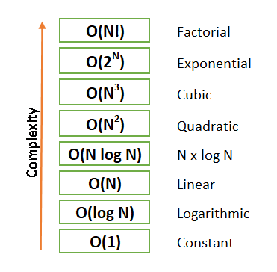
Big O Notation
Big O Notation is a way to measure an algorithm’s efficiency.
There are two parts to measuring efficiency — time complexity and space complexity

Slide 3
Linear Search
Best-case complexity :
O(1) where the element is found at the first index.
Worst-case complexity :
O(n) where the element is found at the last index or element is not present in the array
Binary Search
Best-case complexity :
O(1) where the element is found at the first index.
Worst-case complexity :
O(logn) where the element is found at the last index or element is not present in the array

